Slide 1
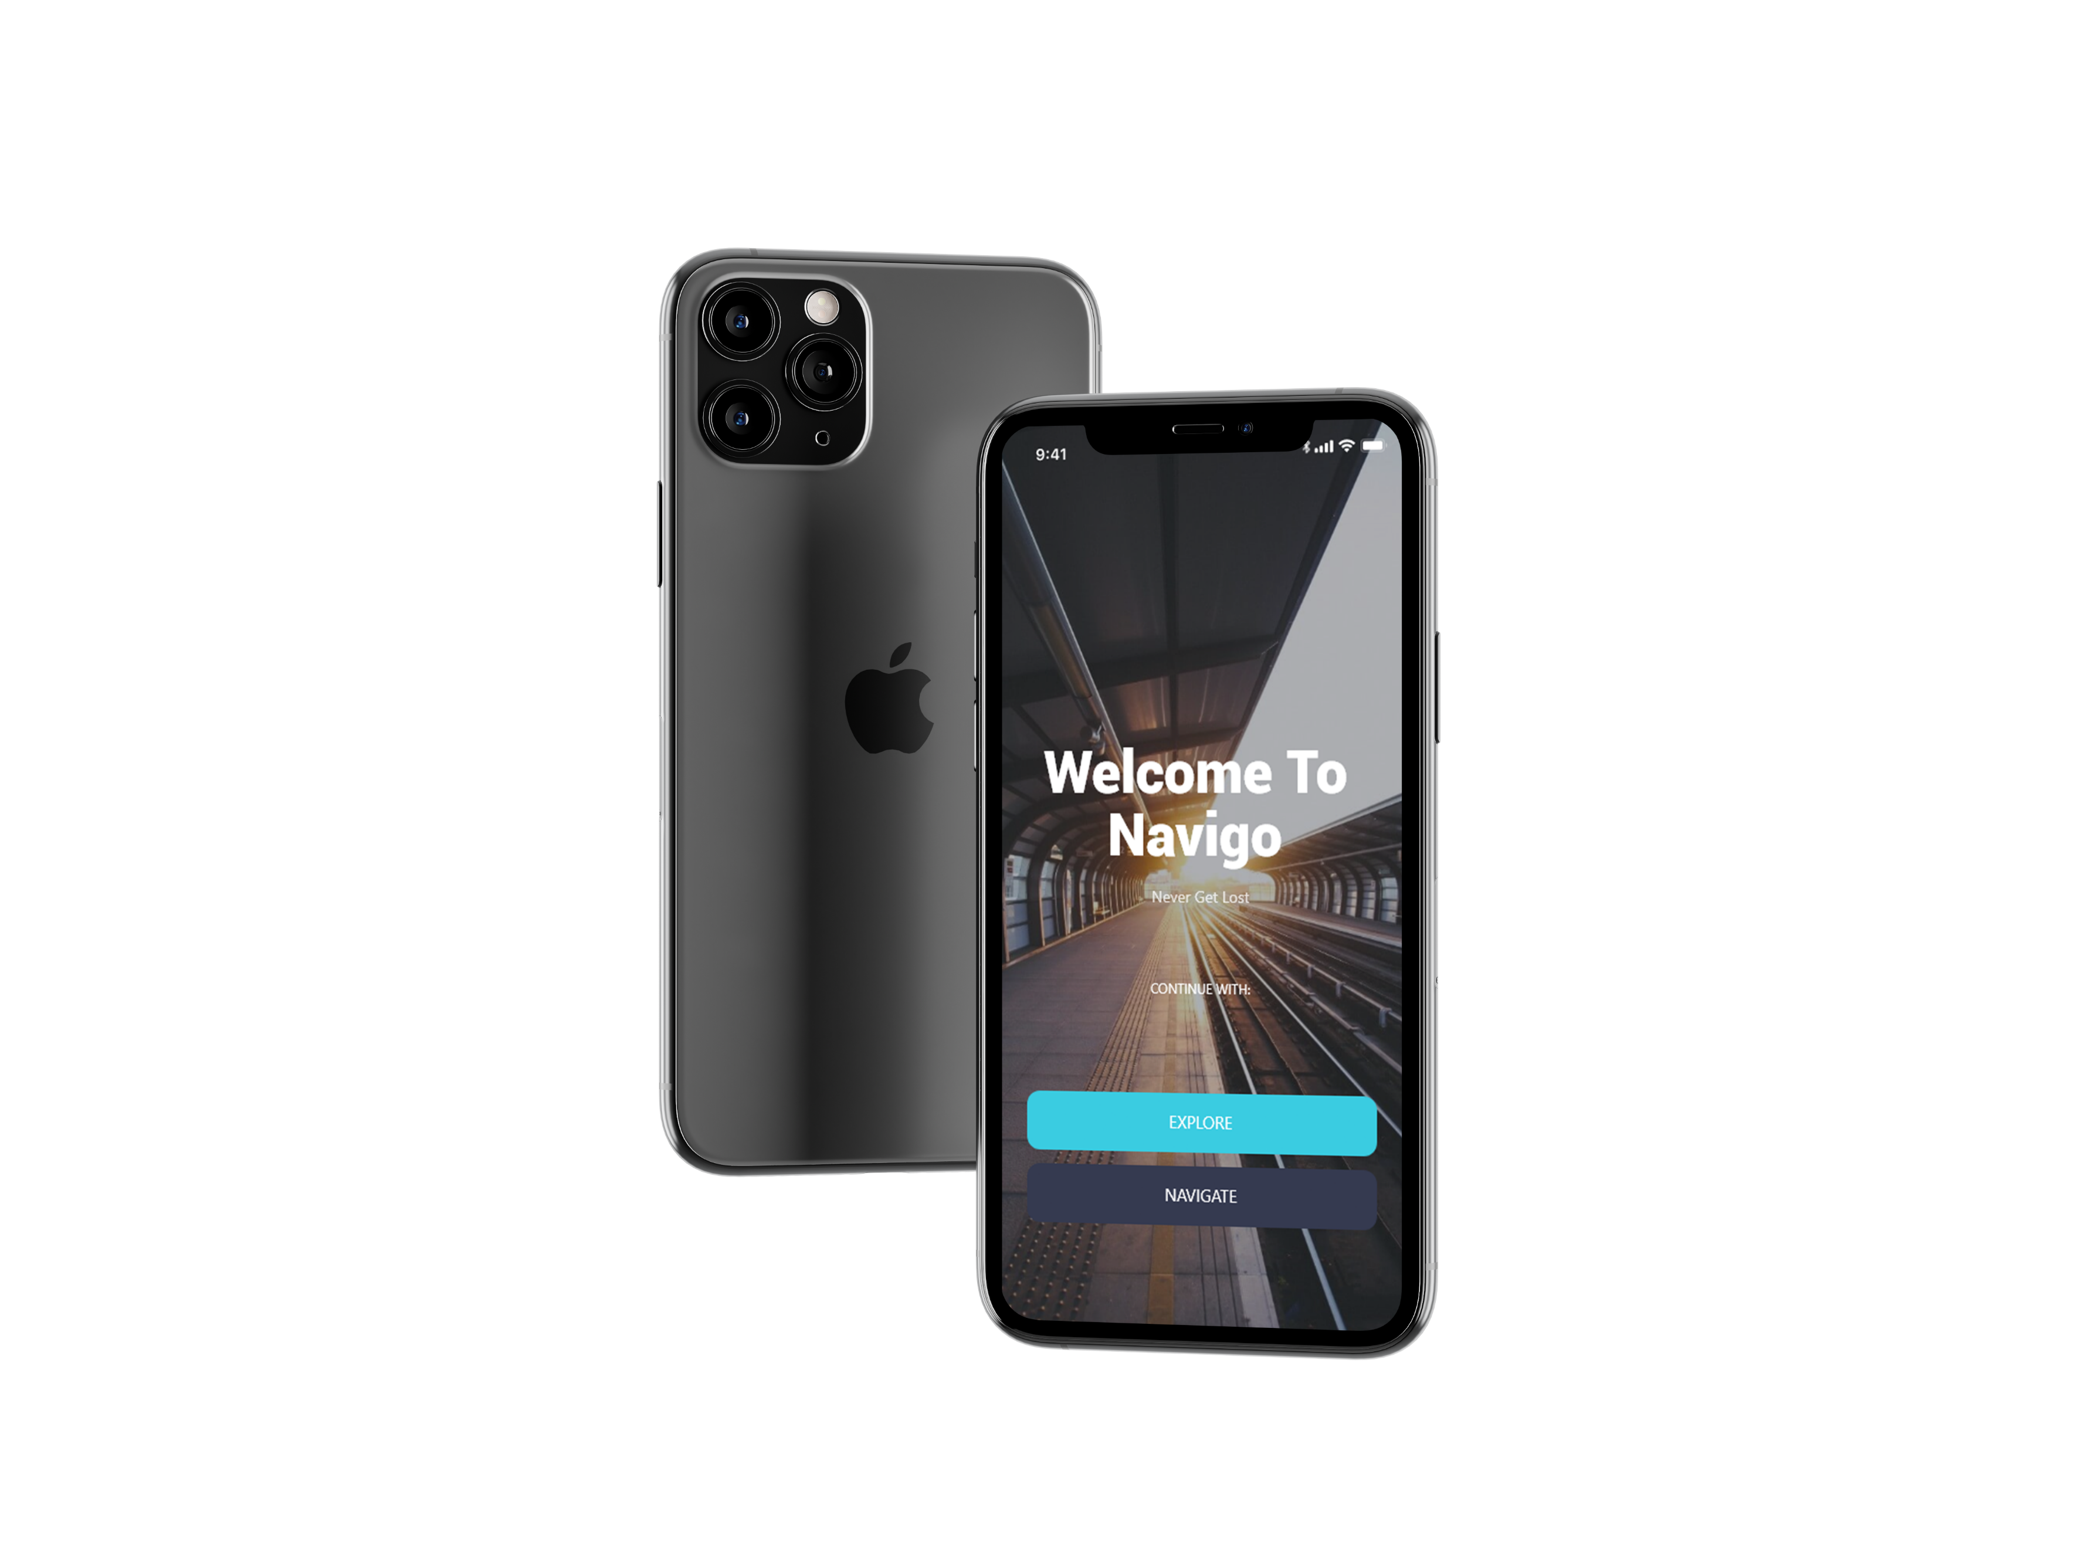
NaviGo
TEAM ALPHA.

Slide 2
ABOUT US
1
Akarsh Ashok
2
Roncy R Thomas
3
Shan Shaji
TEAM ALPHA.
4
Tonal Mathew
5
Joel John Kandathil

Slide 3
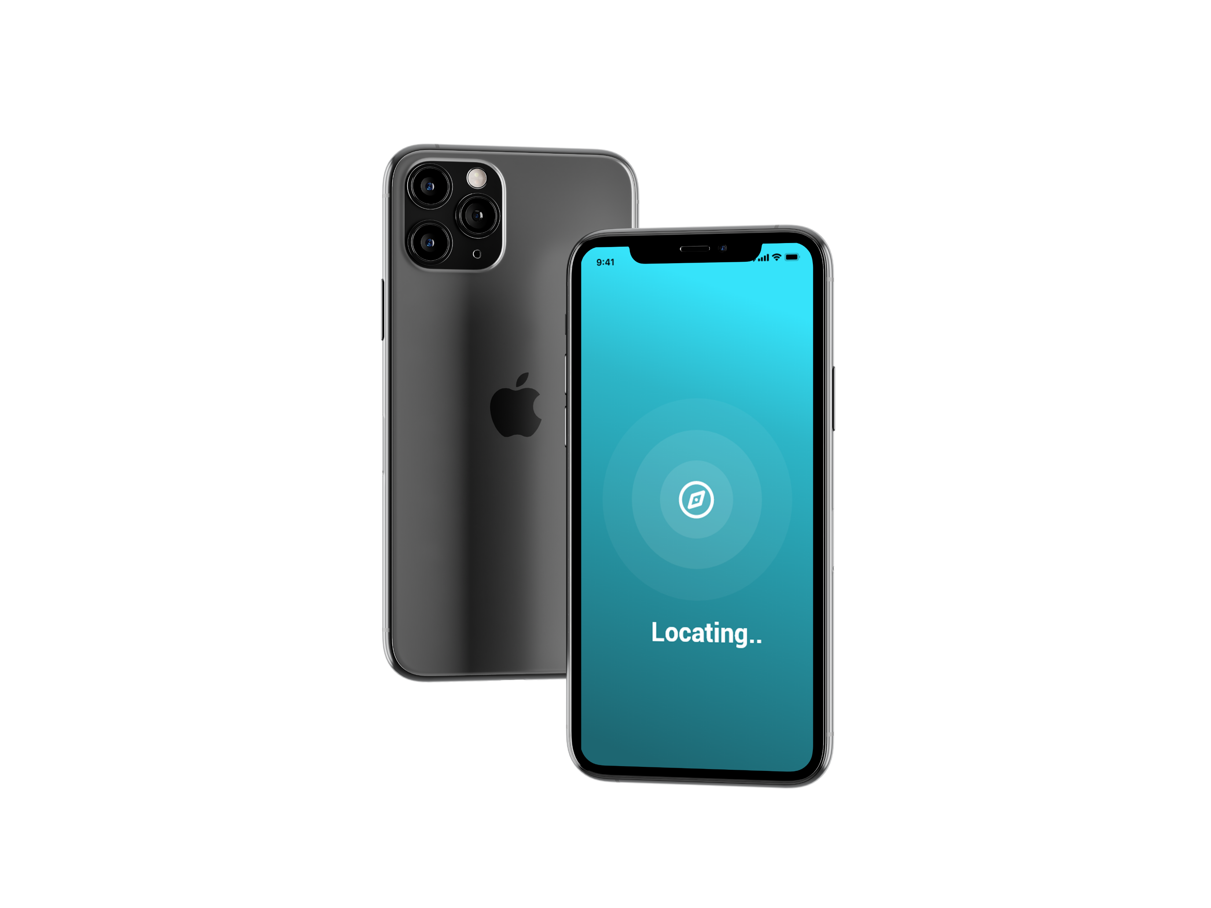
WHAT IS NaviGo APP?

Slide 4
Root
Id
Uid1
Uid2
Category
Hospital
Name
GeoLocation
Description
Name
Description
GeoLocation
Uid1
Uid2
Malls
Doctor
Uid
Name
No of Patient
Days Present

Slide 5
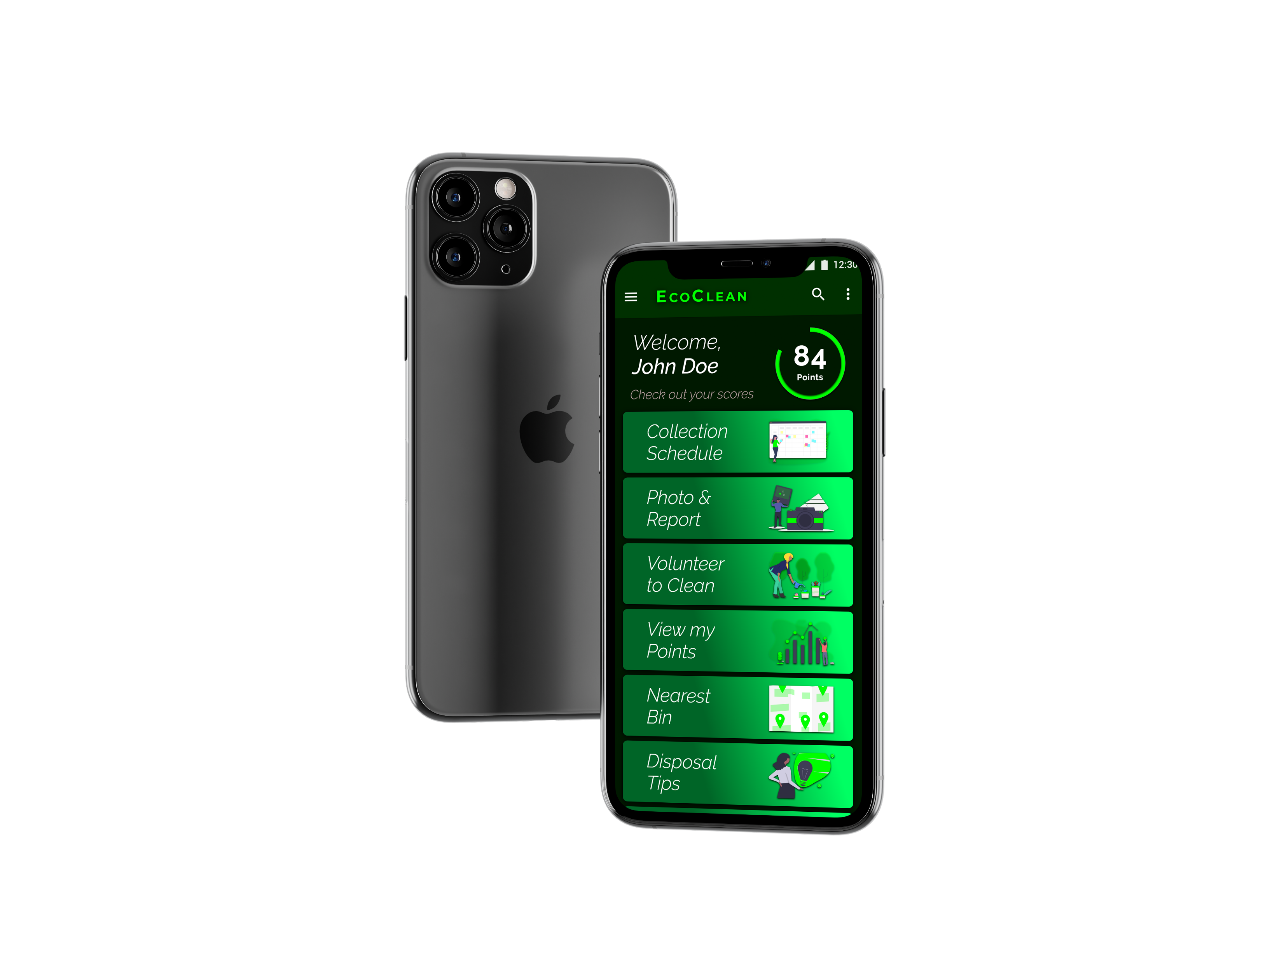
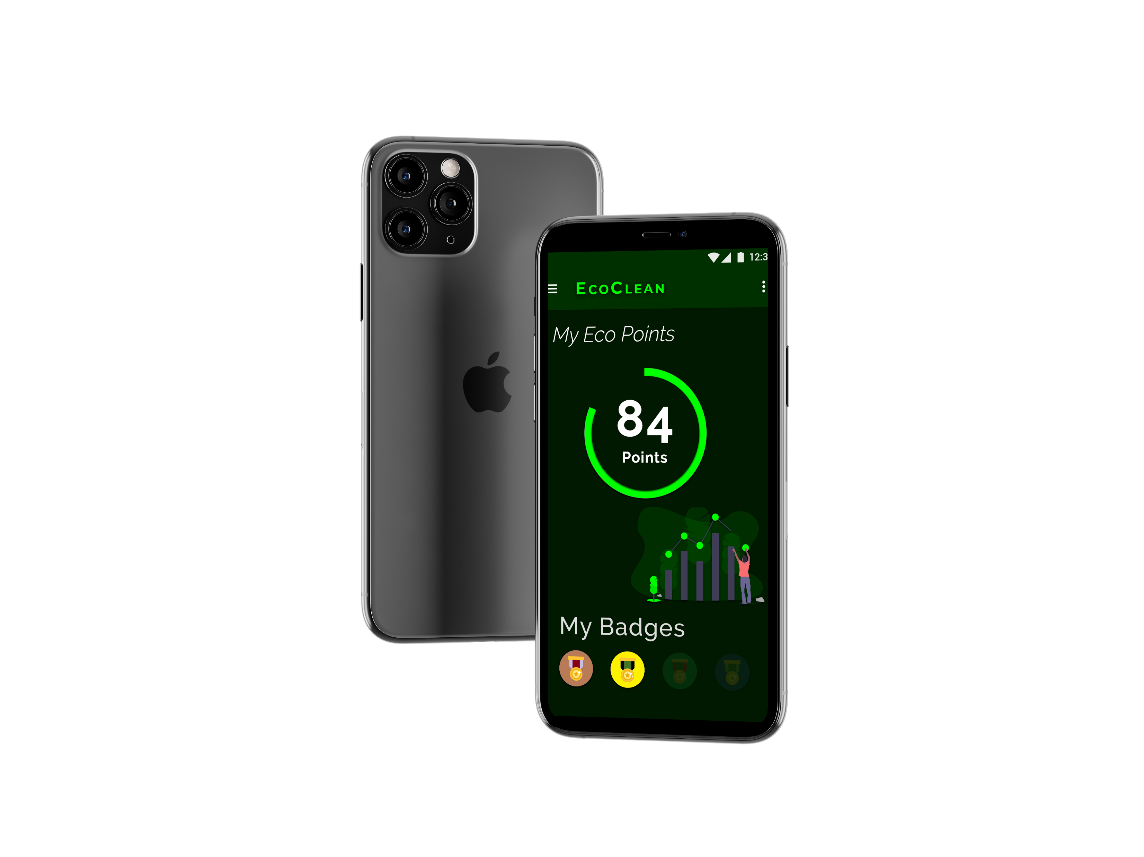
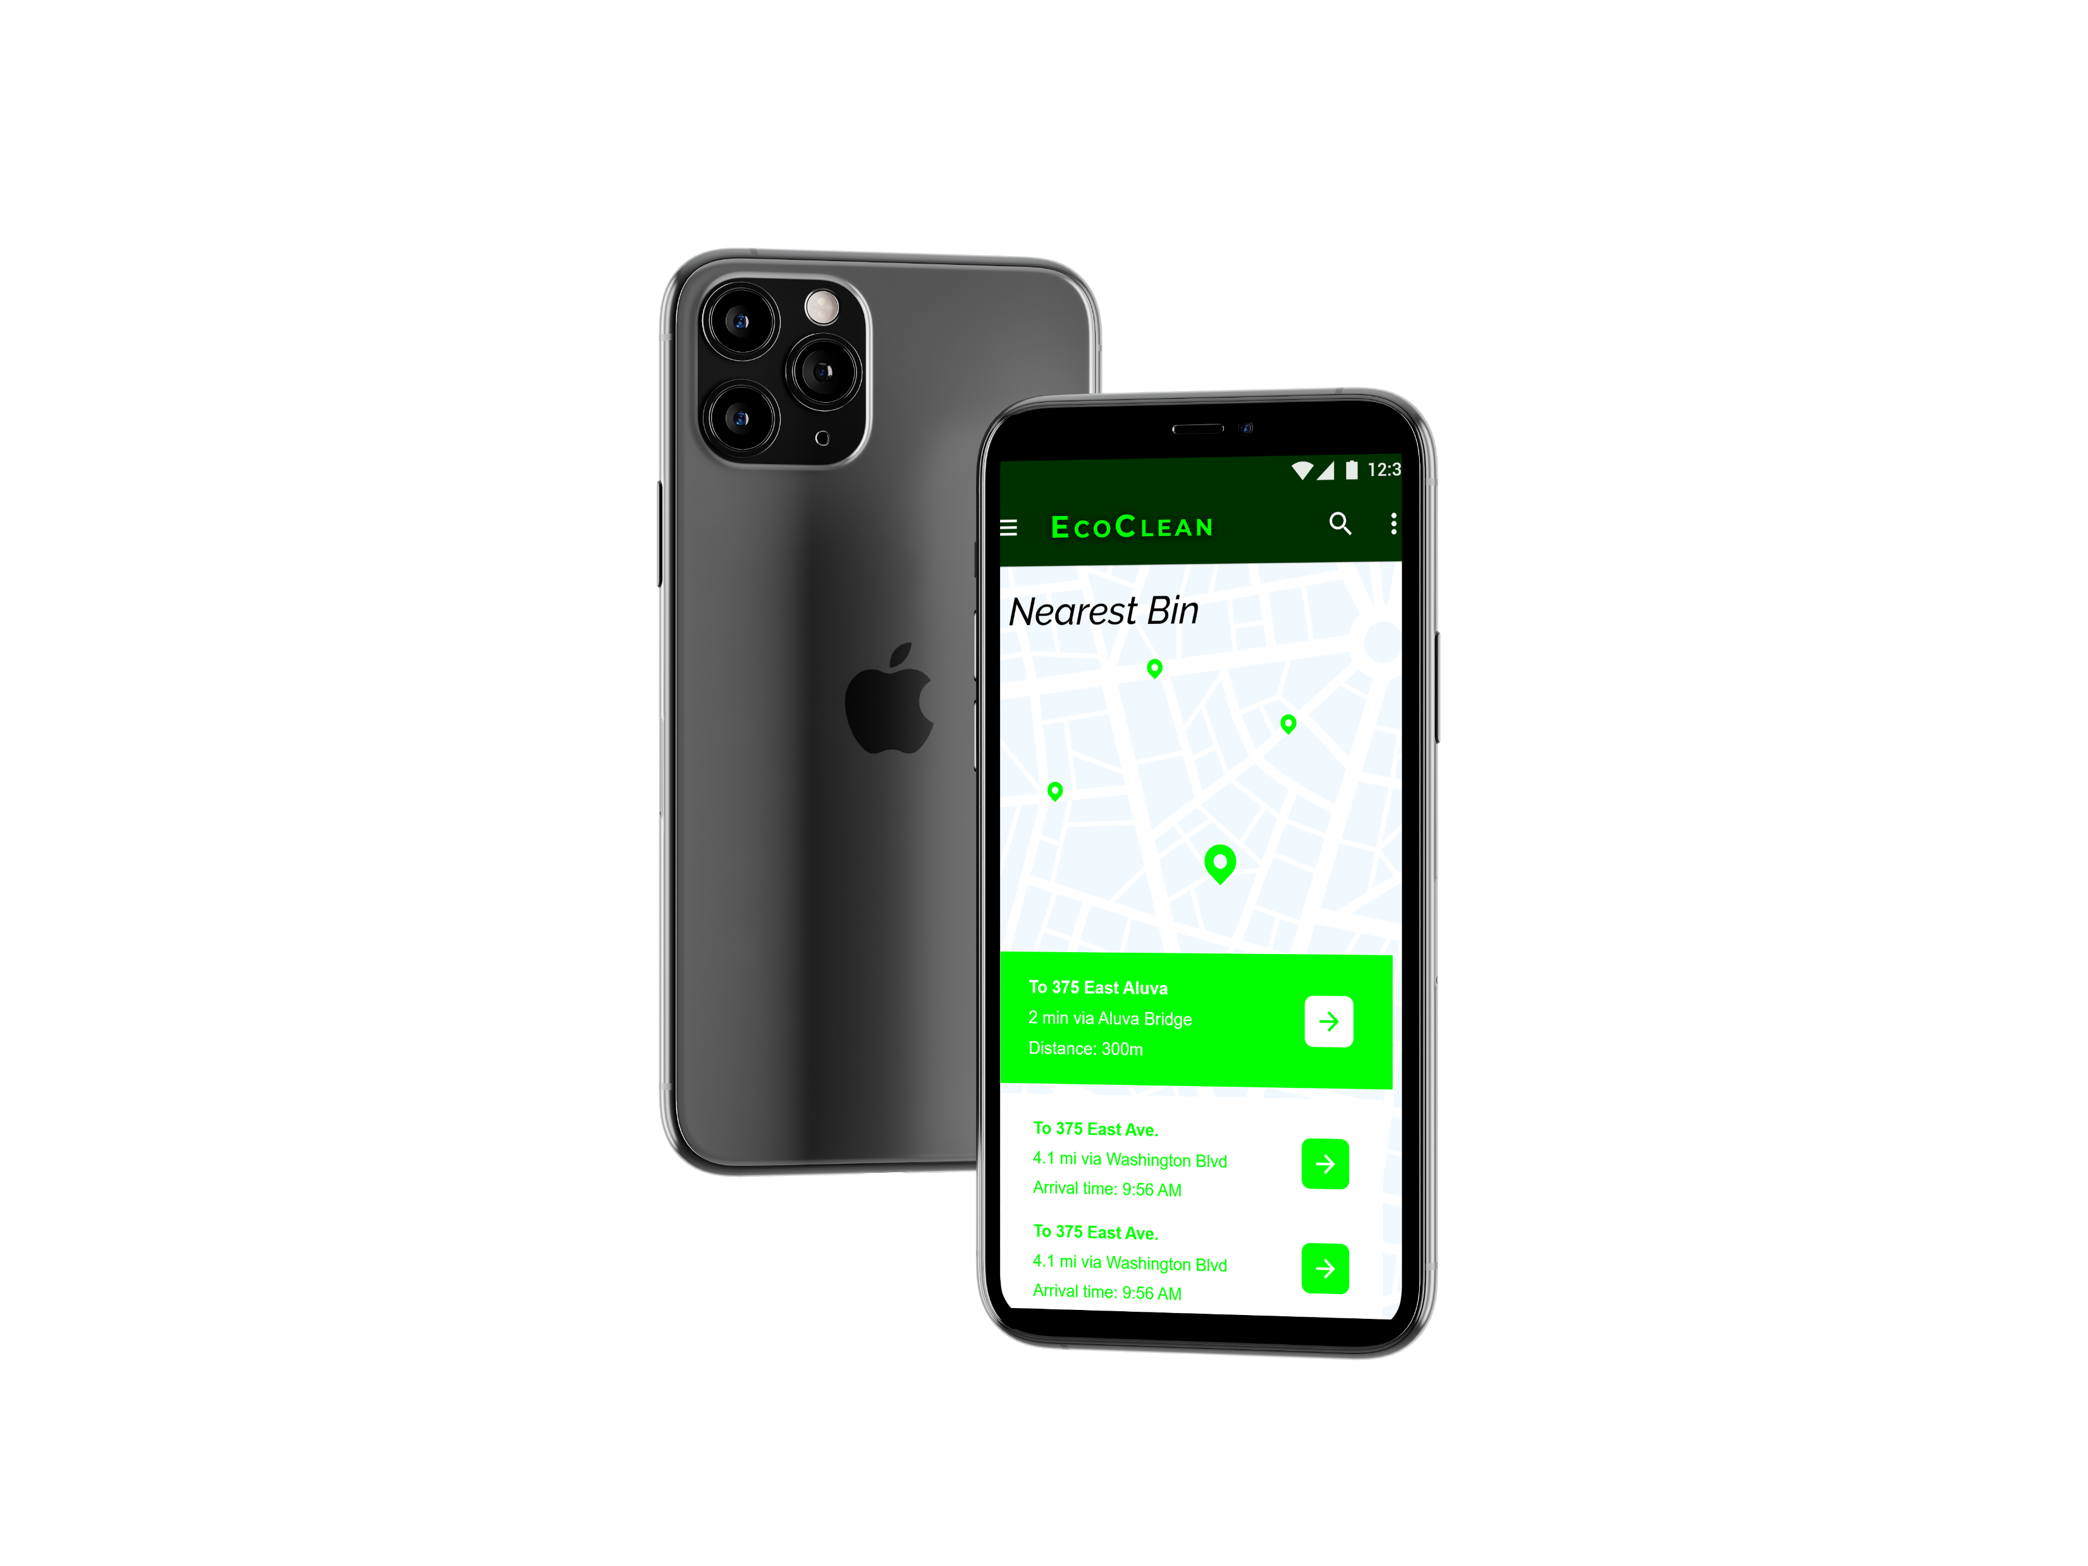
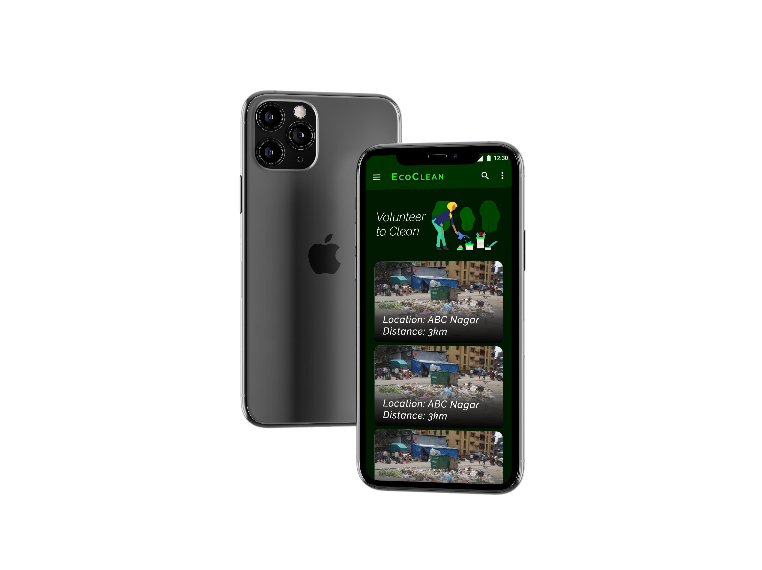
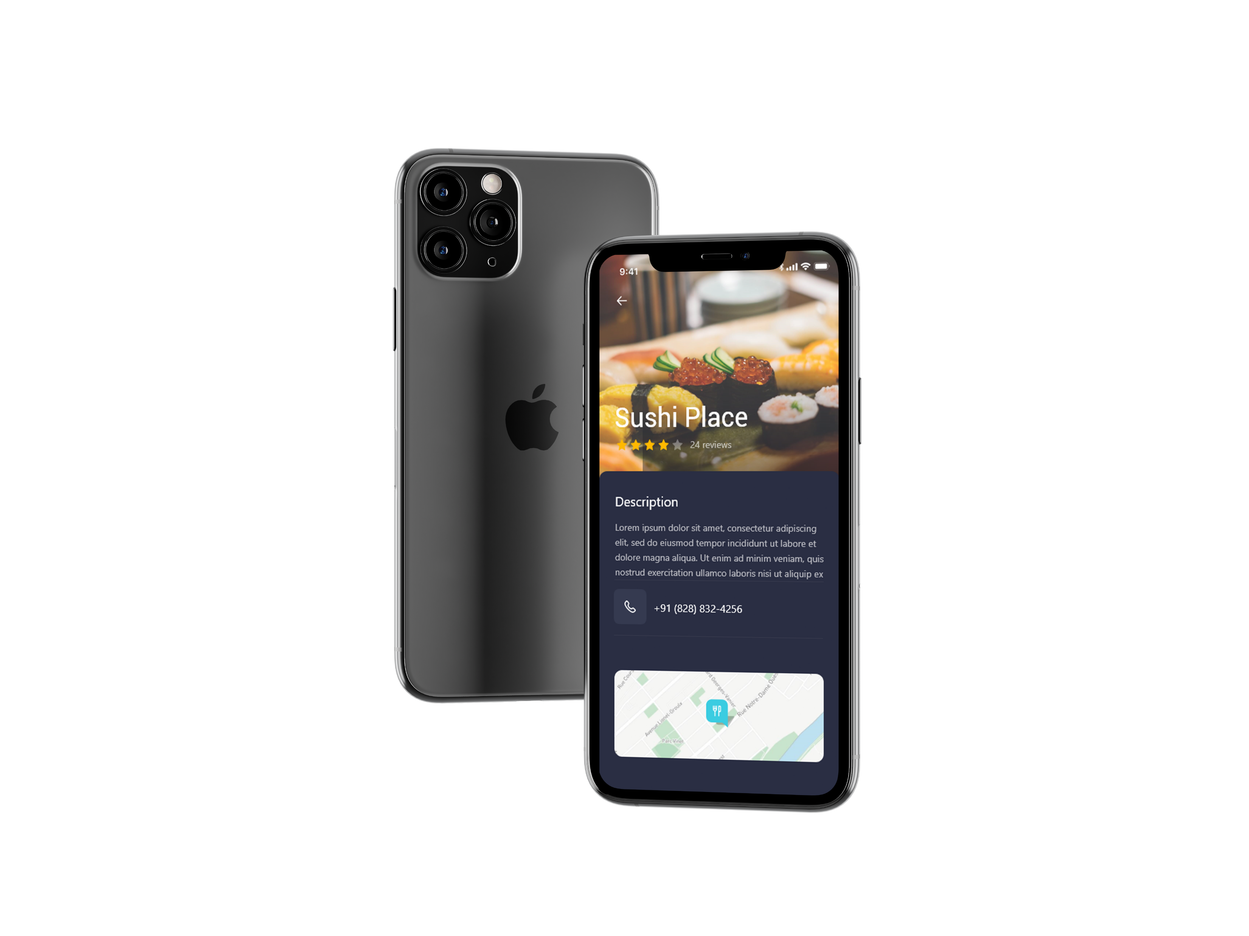
BUSINESS VALUE

Slide 6
THANK YOU!
Team Alpha.

